Slide 1
COMMODITY INTELLIGENCE · PLATINUM ANALYSIS
Gold & Oil Market Intelligence
From data to decisions: what the numbers say, what they cannot say, and what to do next
Team: Ajay Khadke | Akshay Londhe
Gold · Oil · US Dollar Index · CPI inflation · VIX · EIA world oil production

Slide 2
APPROACH
How the analysis was built up
The project moves through four levels. Each adds a layer of meaning on top of the last, ending at the question executives actually care about.
1
2
3
4
Bronze
Silver
Gold
Platinum
Understand the data
Quality and transformation
Business insight
Industry thinking
Load the six datasets, read the columns, confirm date ranges and summary statistics.
Standardise dates, coerce numbers, remove duplicates, flag outliers, build monthly summaries.
Compare gold and oil trends, measure volatility, study trading volume, build executive views.
Add external data, test hypotheses, explain movements, and turn findings into recommendations.
This deck spends most of its time at Gold and Platinum, but every claim traces back to the cleaned data built in Bronze and Silver.

Slide 3
BRONZE · THE BASIC QUESTIONS
What is in the data?
Gold (GLD)
Oil (WTI)
CPI
daily OHLCV
daily price + volume
monthly index
2011 to 2018
2011 to 2018
1947 to 2026
Dollar index
VIX
EIA oil output
daily DTWEXBGS
daily close
annual, world total
2021 to 2026
2021 to 2026
1980 to 2025
6
85
3
1980-2025
datasets joined
shared gold + oil months
date formats parsed
oil output span
Basic questions answered here: which assets, how granular, over what dates, in what shape. The answers set up the first real problem, seen on the next slide.

Slide 4
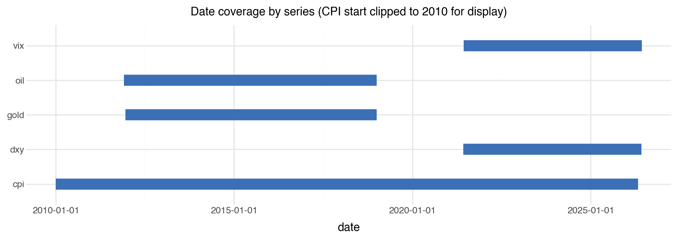
SILVER · DATA VALIDATION
The finding that changes everything
The price files end in 2018. The dollar and volatility files start in 2021.
They do not share a single month. Any test that pairs gold with the dollar or with VIX has no data to run on. The pipeline will not error; it returns empty joins that look like real output.
0 overlapping months
Catching this is the difference between reporting numbers and understanding them.

Slide 5
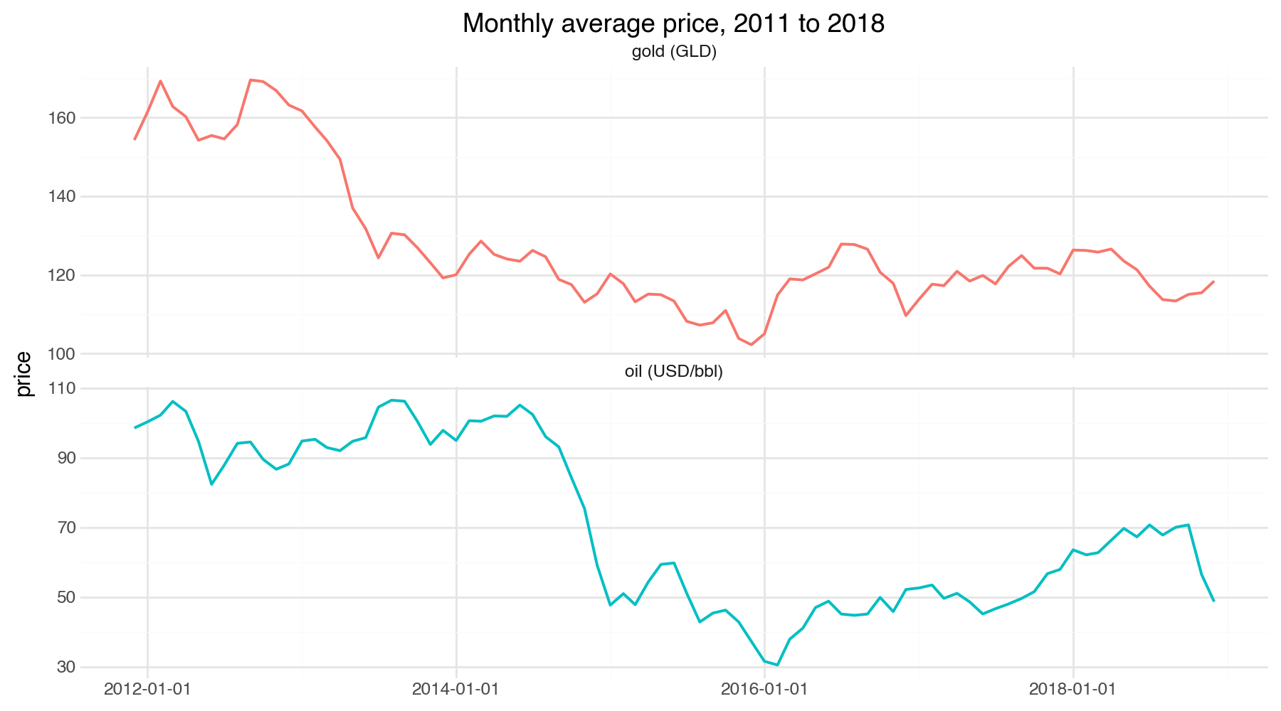
GOLD · WHAT HAPPENED
Both commodities fell across the window
Gold
-23%
154 down to 118 (GLD units)
Oil
-51%
99 down to 49 USD per barrel
This was a commodity bear market, the grind down from the 2011 gold peak and the 2014 to 2016 oil collapse. Not a safe-haven period.

Slide 6
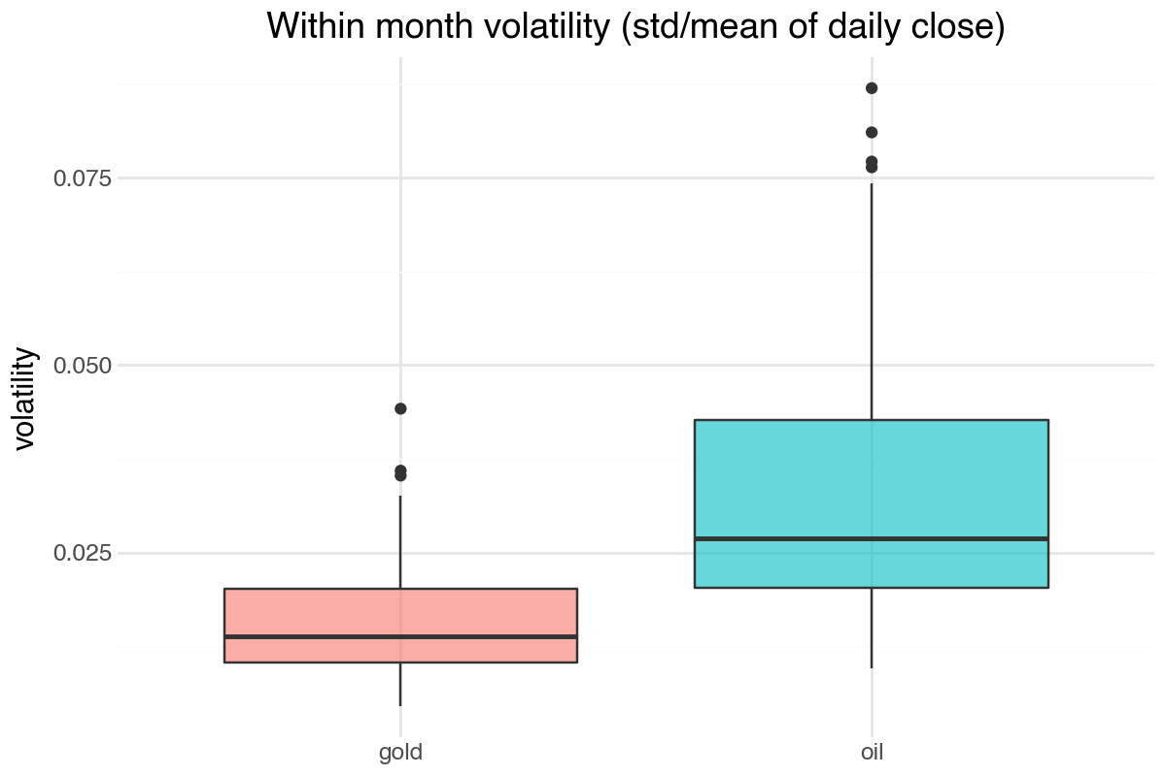
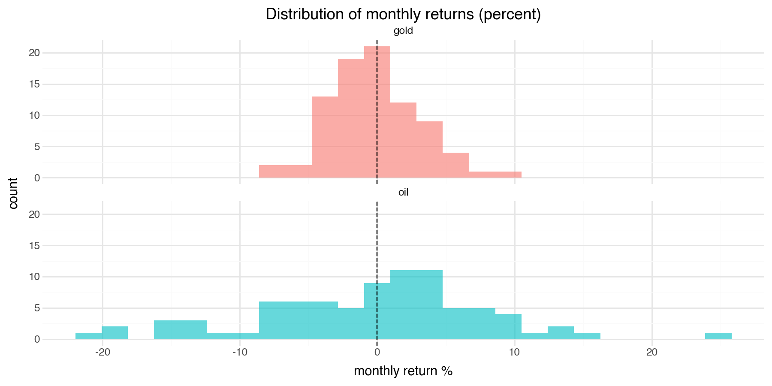
GOLD · WHICH IS MORE VOLATILE
Oil swings about twice as hard as gold
Oil 0.033
Gold 0.016
mean within-month volatility
Most volatile months
Oil: Dec 2014, Jan 2016, Nov 2018
Gold: Apr 2013, Jun 2013, Nov 2016

Slide 7
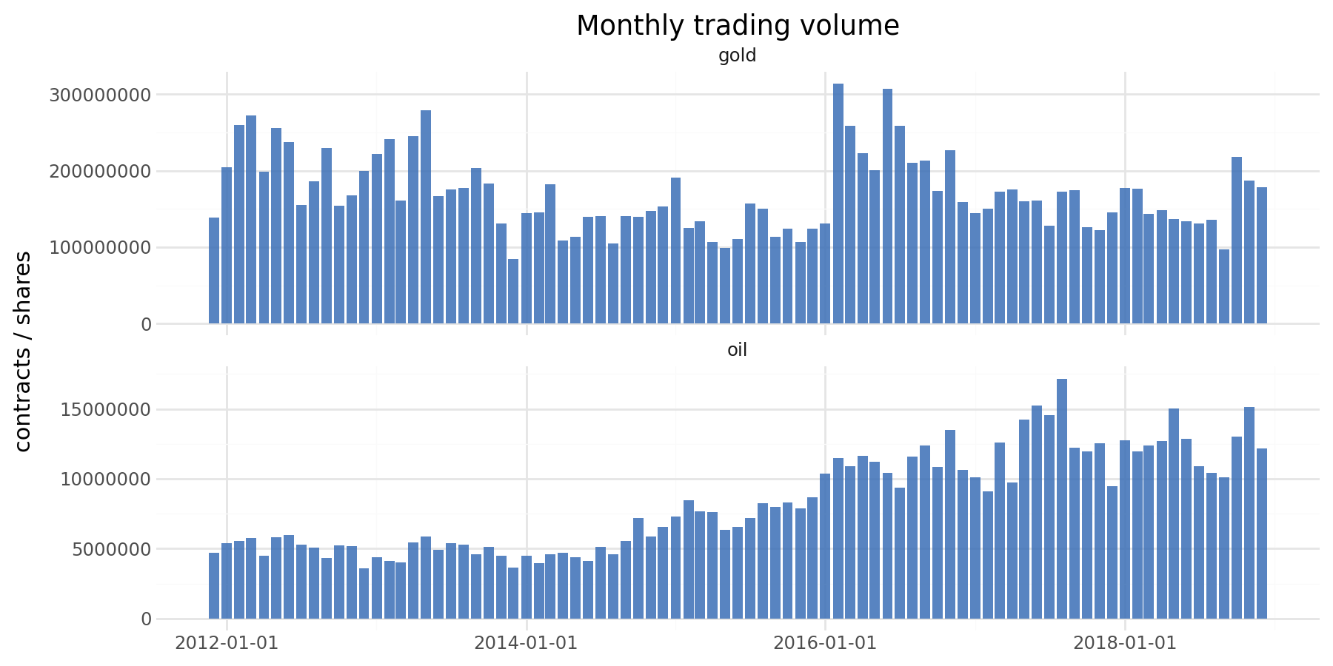
GOLD · TRADING ACTIVITY
When was trading unusually heavy?
Gold peak
Feb 2016
the cycle-low scramble into safe assets
Oil peak
Aug 2017
activity climbed steadily as prices recovered
Outlier check
Zero daily prices flagged at three standard deviations, for both gold and oil. On a series that trends this far, a global z-score catches nothing, a property of the rule, not proof the data is flawless.

Slide 8
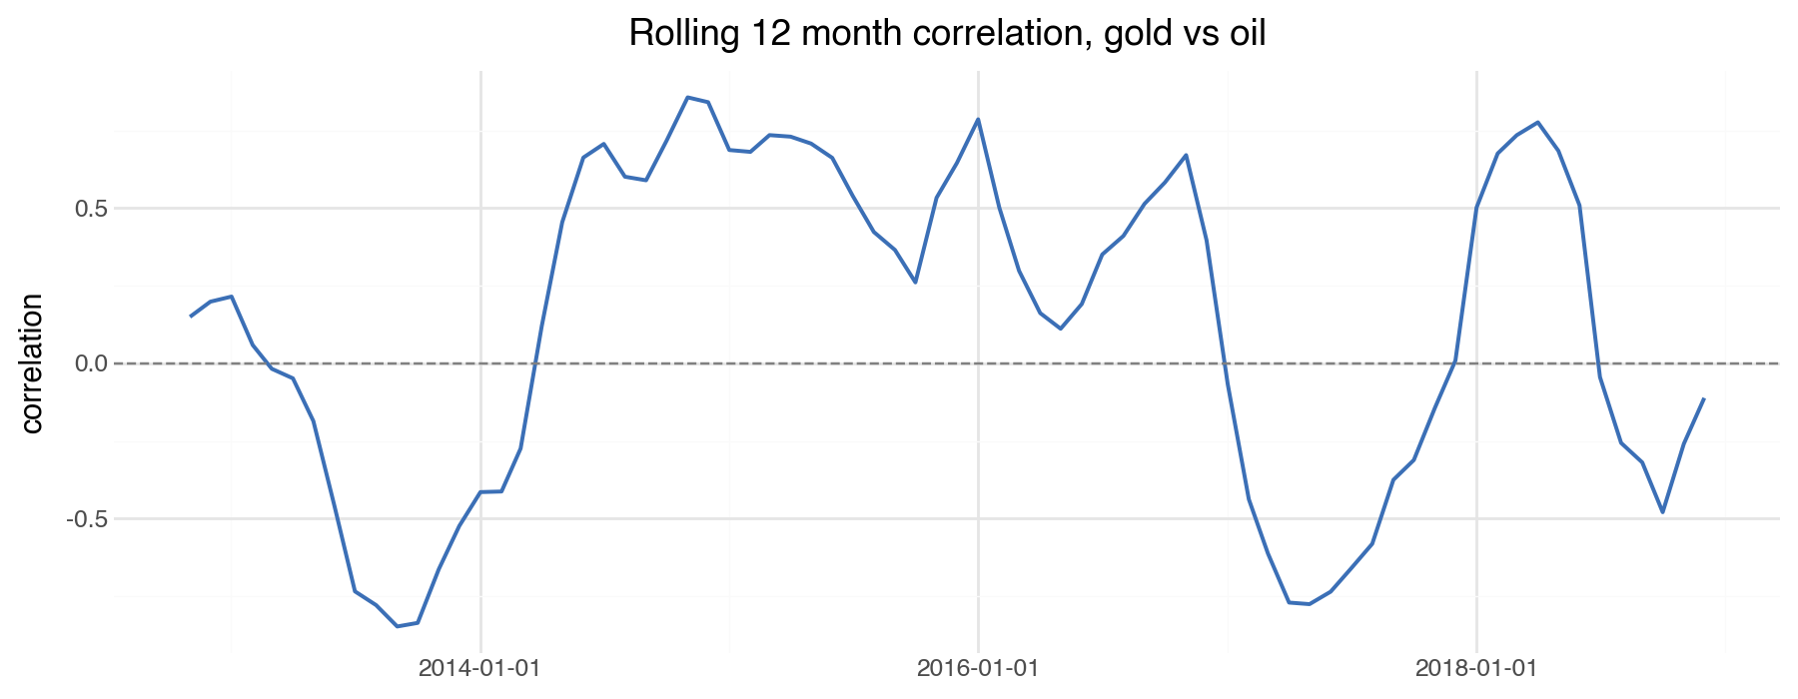
COMBINED · DO THEY MOVE TOGETHER
The relationship is not stable
0.64
correlation on price levels
looks linked, but driven by a shared downward trend
0.01
correlation on monthly returns
month to month, knowing one tells you almost nothing
-0.85 to +0.85
rolling 12-month range
swings between strong positive and strong negative
Report this relationship on a rolling basis. A single correlation number hides the truth.

Slide 9
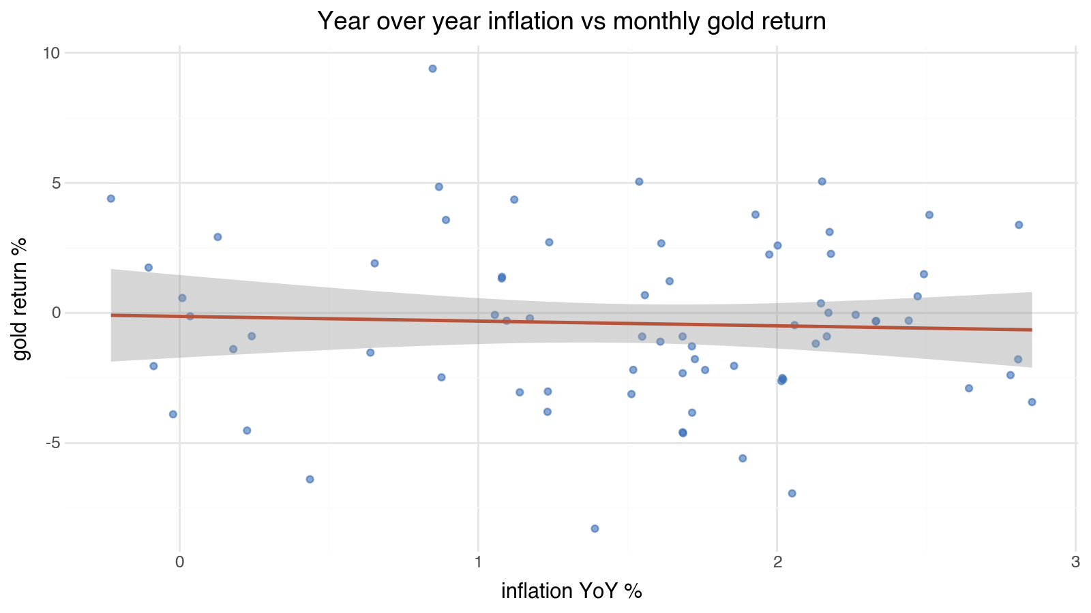
PLATINUM · IS GOLD AN INFLATION HEDGE
Not in this window, and the test agrees
Welch t-test, gold returns
High-inflation months: -0.61%
Low-inflation months: -0.12%
effect -0.49 pp · p = 0.55
What it means
Gold did slightly worse in higher-inflation months, and the difference is not significant. The inflation-hedge story is regime dependent, not a law. In 2011 to 2018, with rising real rates, the hedge simply was not visible. Do not time gold on inflation alone.

Slide 10
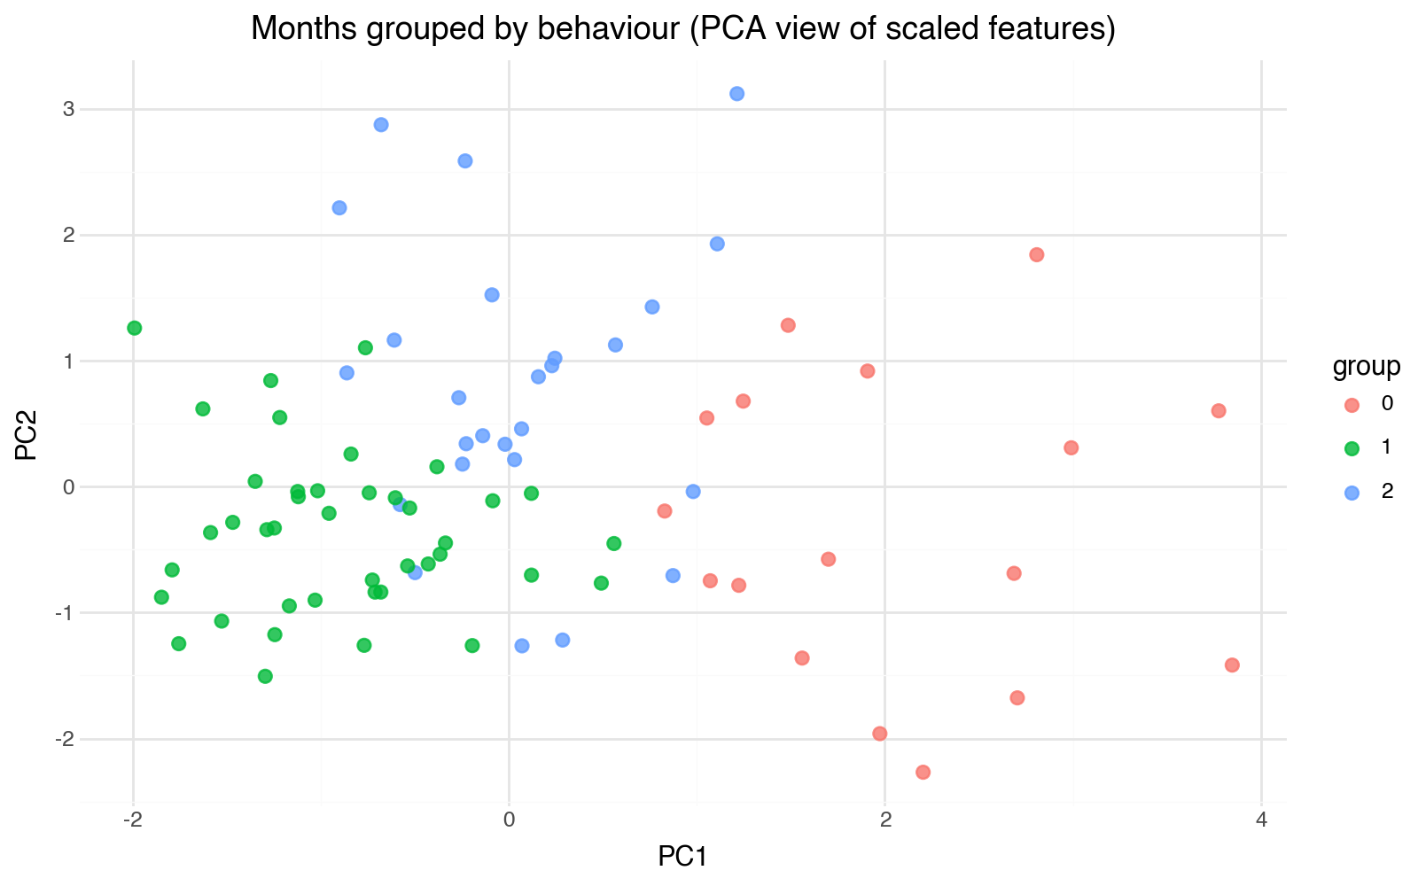
PLATINUM · PATTERN DISCOVERY
Grouping months by behaviour (scikit-learn)
Method
Features: gold and oil returns, gold and oil volatility, and inflation.
Pipeline: median imputation, then standard scaling.
KMeans groups the months; PCA projects them to two dimensions so the groups can be seen.
Read this as exploration, not prediction. The groups separate calm months from high-volatility months; they are a lens for further questions, not a trading signal.

Slide 11
PLATINUM · EVIDENCE
Hypothesis scorecard: be honest about what ran
ID | Question | Data? | Verdict
H1 | Gold higher when the dollar weakens | None | Untestable: no dollar overlap
H2 | Gold higher in high-inflation months | Yes | Not significant (p = 0.55)
H3 | Oil higher when world output falls | Degenerate | Undefined: one cut year only
H4 | Gold higher in stressed (high-VIX) months | None | Untestable: no VIX overlap
H5 | Gold returns track changes in VIX | None | Untestable: no VIX overlap
H6 | Gold moves inversely to the dollar | None | Untestable: no dollar overlap
One of six runs cleanly, one is undefined, four are empty. A naive run would print "4 of 6 rejected" off silent empty joins. That would be fiction.

Slide 12
FRAMEWORK
The five levels of analysis
1
What happened
Gold -23%, oil -51%; oil about twice as volatile; returns nearly uncorrelated.
2
When
Oil's damage in 2014 to 2016; gold's sharp moves in 2013 and late 2016.
3
Where
Not applicable: these are global benchmark prices with no geography.
4
Why
Inflation did not explain gold (p = 0.55); the dollar and VIX drivers are unmeasurable here.
5
What next
Align the data in time, then re-test. Recommendations follow.

Slide 13
PLATINUM · DELIVERABLE
Business recommendations
Fix the time-coverage gap first
Get gold and oil for 2021 to 2026, or the dollar and VIX back to 2011, so they overlap. Until then H1, H4, H5 and H6 stay formally open.
1
Re-align the event study
The Ukraine, SVB and OPEC events sit after the price data ends. Point them at prices that exist before measuring impact.
2
Treat the inflation hedge as conditional
Gold was not a hedge in this window. Combine inflation with real rates and the dollar, and re-test on overlapping data.
3
Use world oil supply as backdrop only
One production-cut year cannot support a signal. Replace the annual series with a true monthly crude series.
4
Always report gold-oil on a rolling basis
The level correlation of 0.64 misleads. The rolling return correlation, mean 0.12 swinging widely, is the honest view.
5

Slide 14
THE BOTTOM LINE
The engineering is sound. The data needs alignment in time, not more analysis.
Answered: what happened, how volatile, and whether gold and oil move together.
Open until data aligns: the dollar, the safe-haven, and the volatility questions.
Building trust in the data is worth more than building another dashboard.

